Slide 1
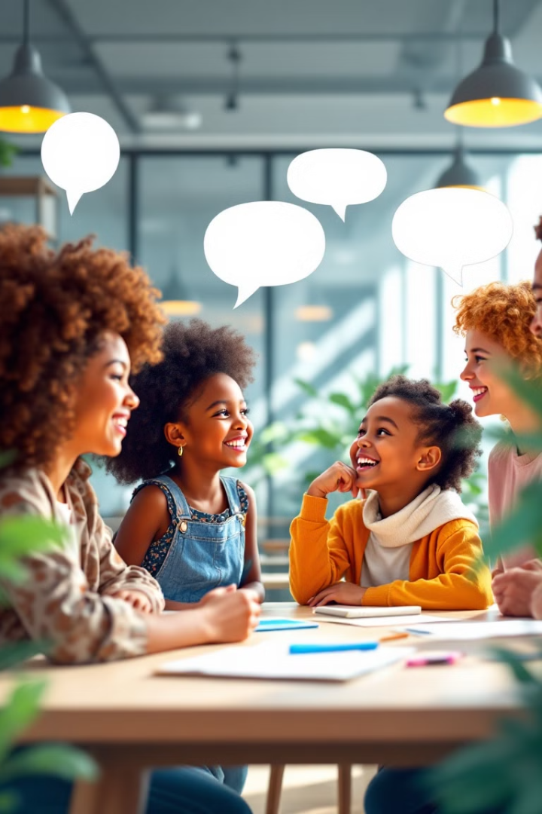

Topic: Greetings and Self-Introductions
Self-Introduction;
Formal and informal Greetings;
Exercises.
by Lucas Hortencilio

Slide 2
Formal vs. Informal Greetings
Formal Greetings
Informal Greetings
Is used in professional, official, or respectful situations. Appropriate when speaking to someone for the first time, addressing an authority figure, or in business and academic environments.
Is used among friends, family, and peers in casual occasions. They are more relaxed and friendly compared to formal greetings.

Slide 3
Formal Greetings: Examples
1
Good morning
Response: Good morning to you too.
2
Good afternoon
Response: Good afternoon.
3
Good evening
Response: Good evening.
4
Good night
Response: Good night.

Slide 4
Asking someone’s health
How are you?
Are you fine?
Are you good?
How are you feeling?
Is everything ok?
Are you heathy?
Are you feeling good?
Possible answers
I am fine thanks.
Yes, I am.
I am good, thank you.
I am feeling very good.
Yes, it is.
Yes, thanks a lot.
Better than ever, thanks.

Slide 5
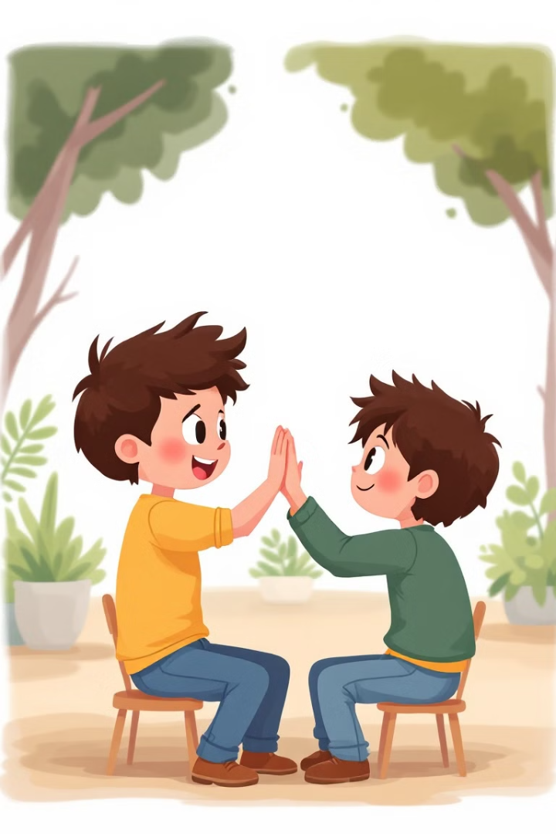
Informal Greetings: Examples
Hey! / Hi! / Hello!
Response: Hey! / Hi! / Hello!
What's up?
Response: Not much, you?
How’s it going?
Response: Pretty good, how about you?
How is it!
Response: So far, so good, and there?

Slide 6
Informal of greetings
Greeting
Long time no see!
How’s everything!
How have you been?
How is your life?
Hey!/ Hi!/ hello!
What’s up?
How is it going?
How is it?
Answer
Long time no see!
Everything is going well.
So so.
Fine, and yours?
Hey!/ Hi!/ Hello!
I am sick.
Pretty good.
So far so good.

Slide 7
How to answer back when someone asks how we are:
And you?
How about you?
What about You?
And there?
Different ways to say that you also have the same feeling
Me too.
I am also good
I am good as well
Likewise
The same as you

Slide 8
Farewells
When we dismiss someone we often say:
Goodbye/ bye.
See you later.
See you tomorrow.
Have a good day.
I have to go.
See you.
See you when you see me.

Slide 9
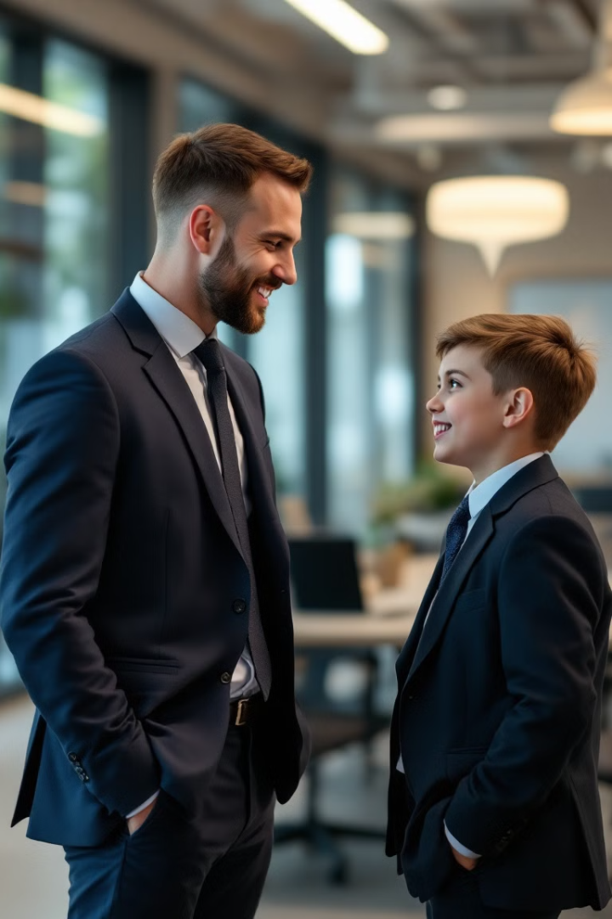



Formal Greetings: Dialogue
Person A: Good morning, Mr. Smith. How are you today?
Person B: Good morning. I am doing well, thank you. And you?
Person A: I’m fine, thank you.

Slide 10
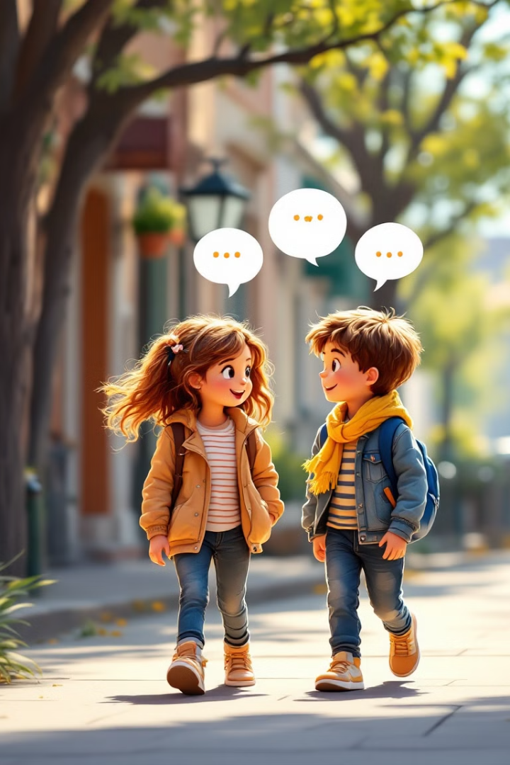
Informal Greetings: Dialogue
1
Person A: Hey, what's up?
2
Person B: Not much, just chilling. You?
3
Person A: Same here! / Likewise.

